Slide 1
AEM – Adobe Experience Manager

Slide 2
What is AEM
AEM stands for Adobe Experience Manager. It is a comprehensive content management solution for building websites, mobile apps, and forms. AEM is part of the Adobe Experience Cloud, which provides tools for managing and optimizing the customer experience across different digital channels.
Key Features of Adobe Experience Manager:
Content Management: Manage website content and digital assets, delivering them to different channels.
Assets: Manage and deliver images, videos, and other digital assets.
Forms: Create and manage forms and documents.
Personalization: Use data and machine learning to deliver personalized experiences to different segments of your audience.
Integration: Seamlessly integrates with other Adobe products and third-party systems to provide a cohesive digital experience.
Scalability: Designed to support large-scale websites and content delivery needs, AEM can handle high traffic and large volumes of content.
Authoring Tools: Provides a user-friendly interface for content authors to create and manage content without needing technical expertise.
Multisite Management: Manage multiple websites and digital properties from a single platform, ensuring consistency and efficiency.
Digital Asset Management (DAM): Centralized repository for storing, organizing, and retrieving digital assets.
Analytics and Reporting: Built-in analytics tools to measure and analyze the performance of your content and digital experiences.
Workflows and Collaboration: Streamline content creation and approval processes with customizable workflows and collaboration tools.

Slide 3
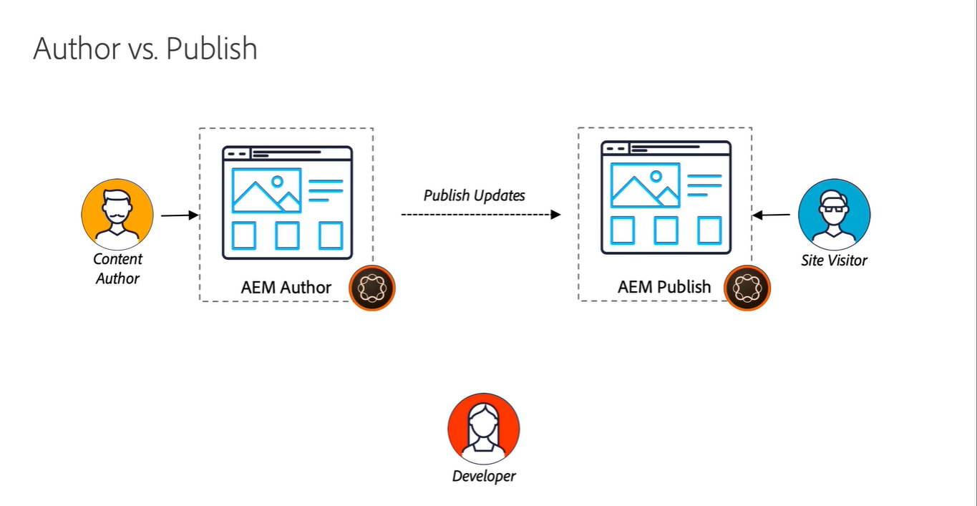

Slide 4
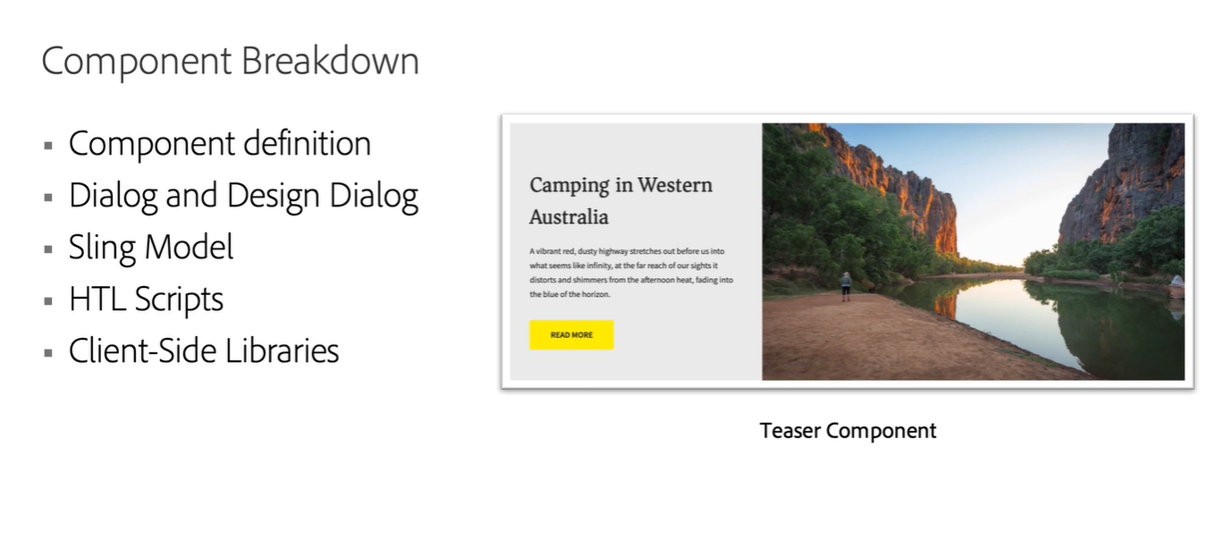

Slide 5
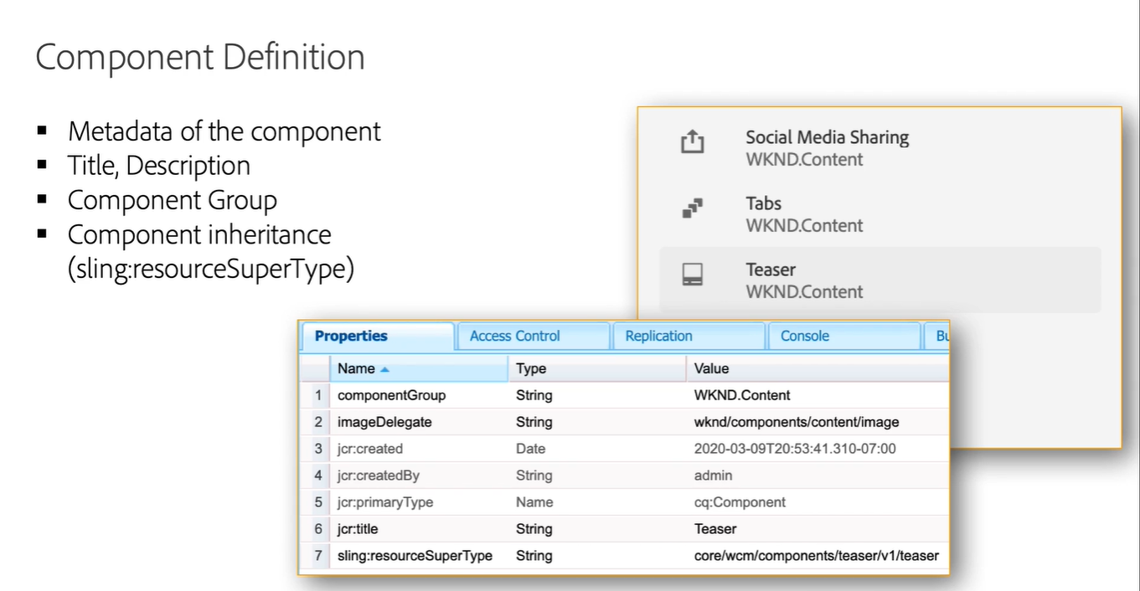

Slide 6
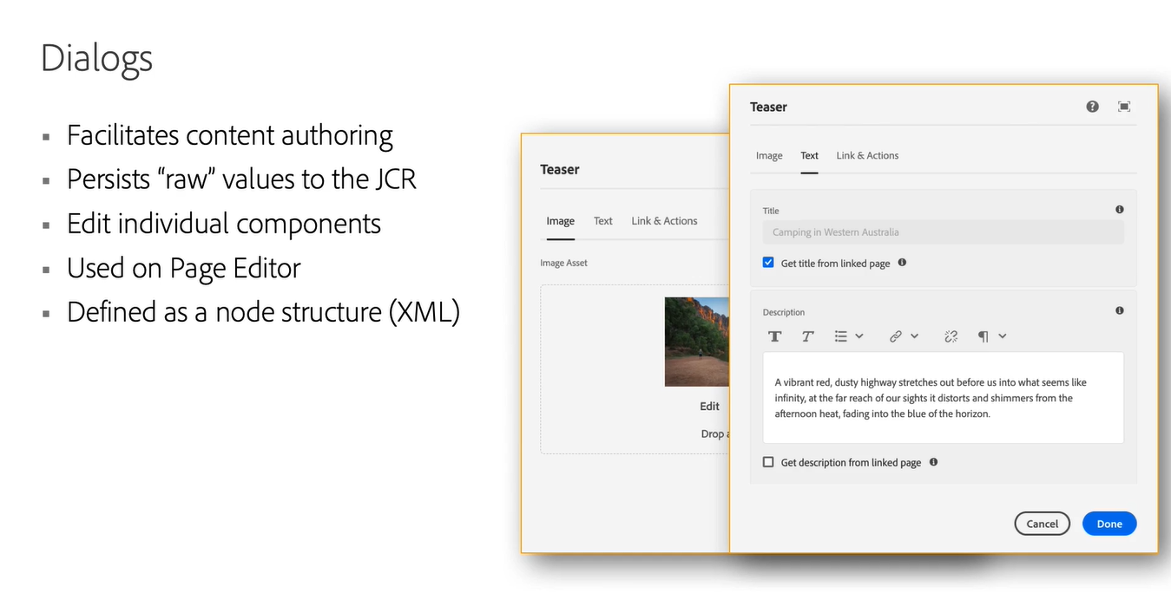

Slide 7
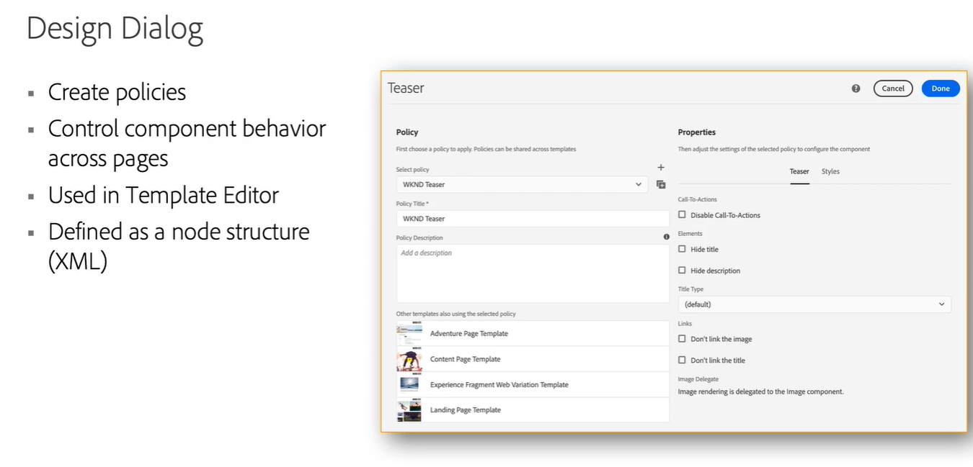

Slide 8
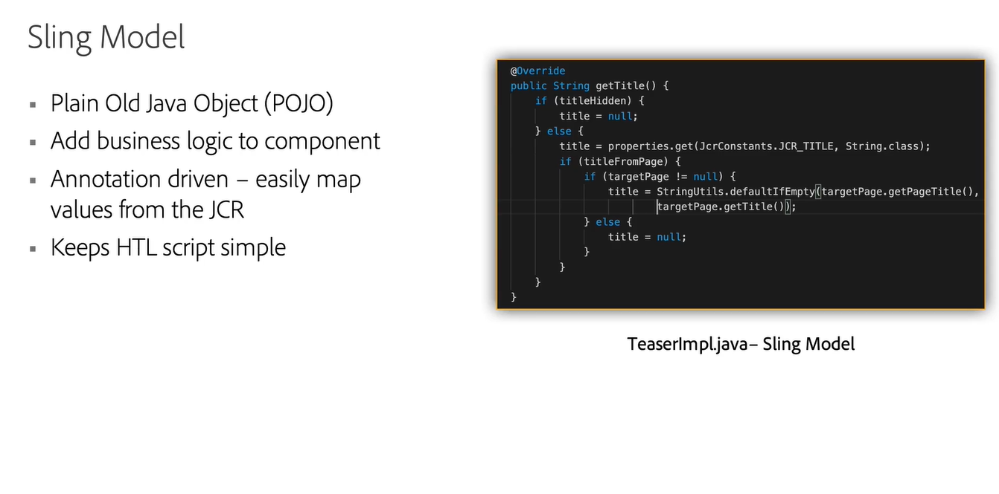

Slide 9
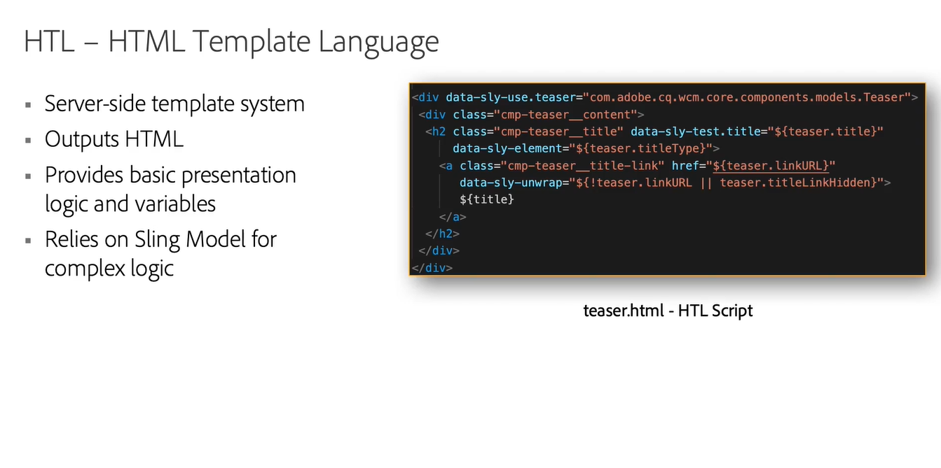

Slide 10
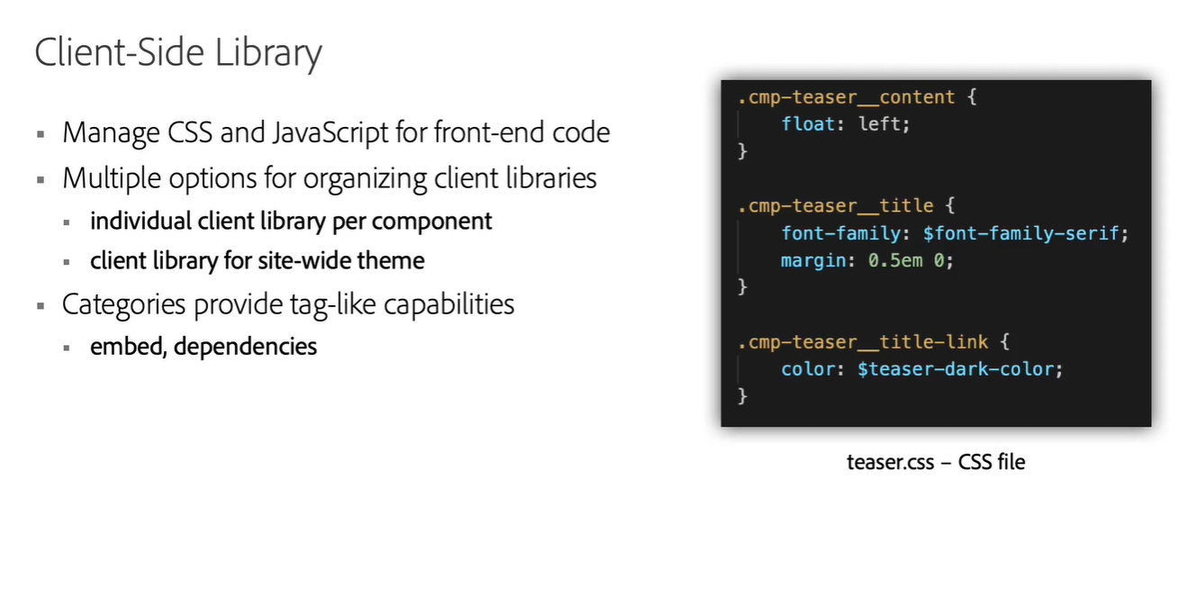

Slide 11
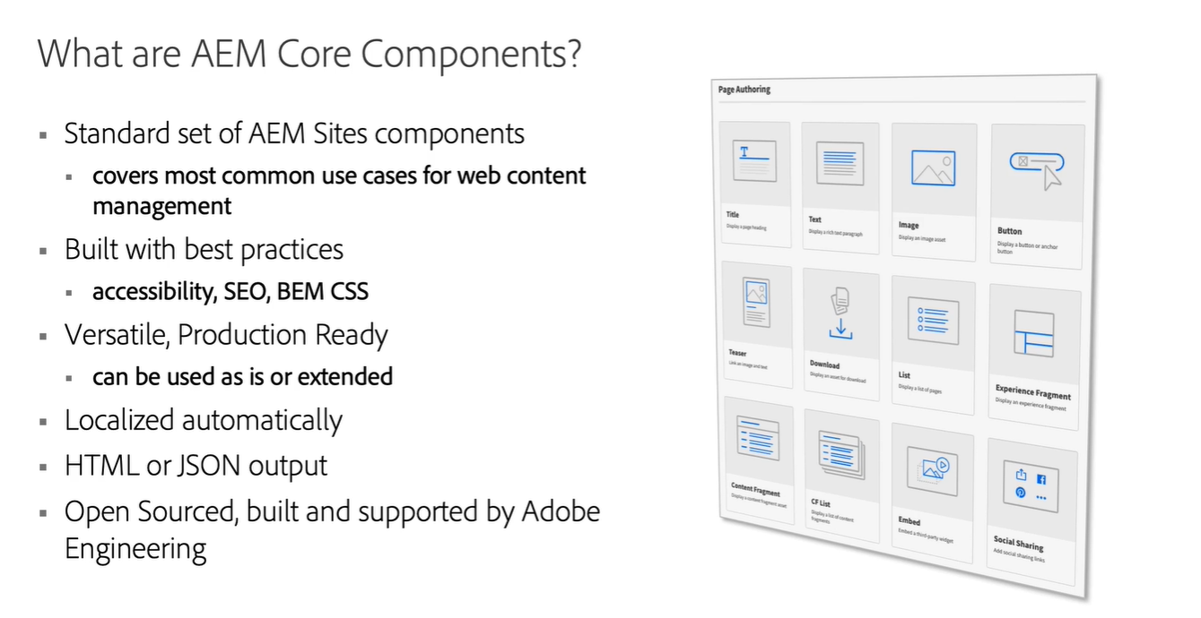

Slide 12
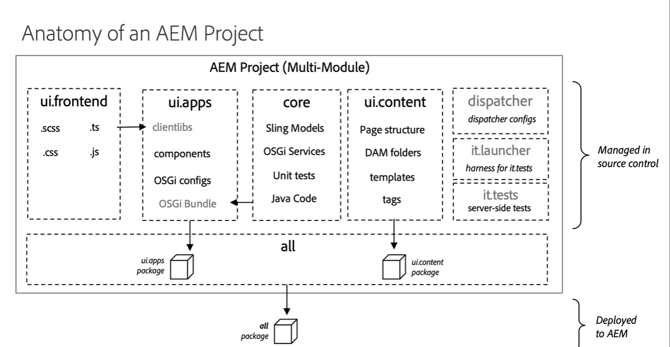

Slide 13
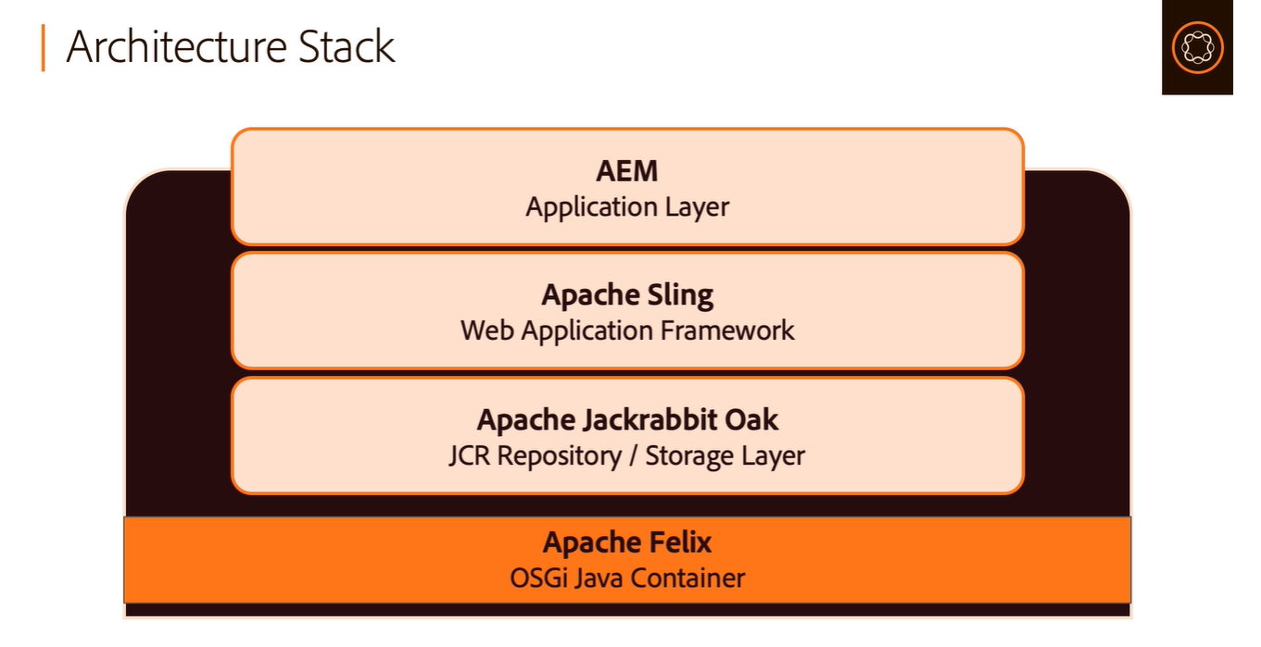

Slide 14
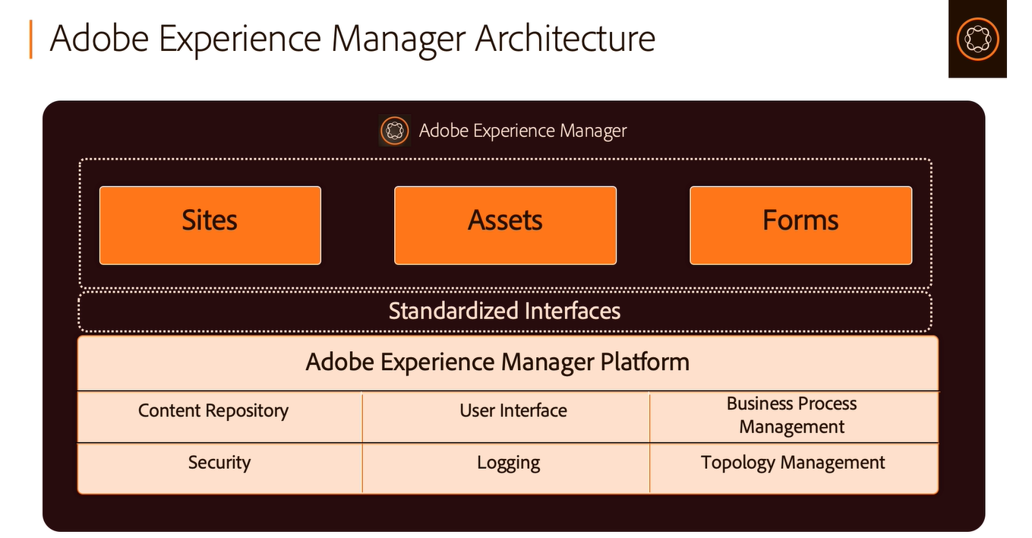

Slide 15
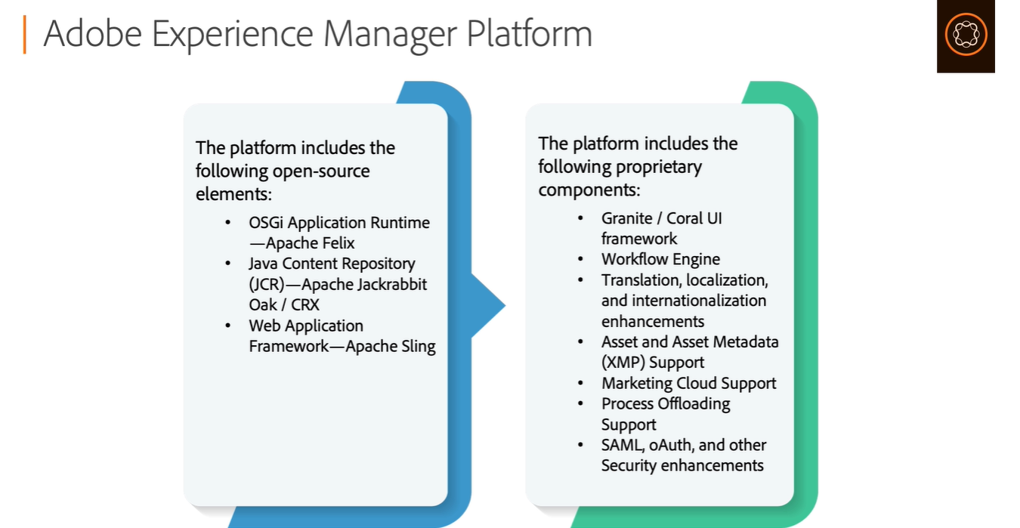

Slide 16
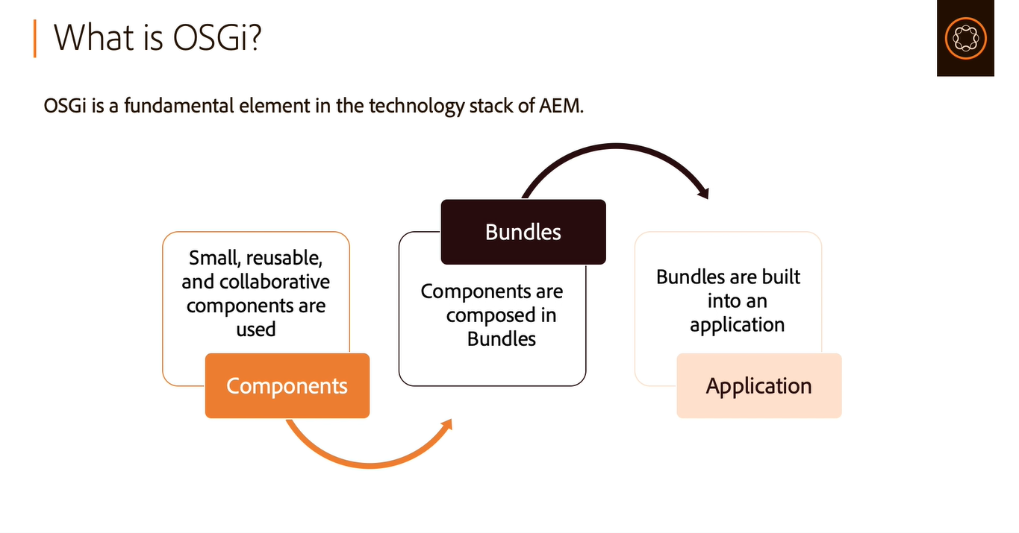

Slide 17
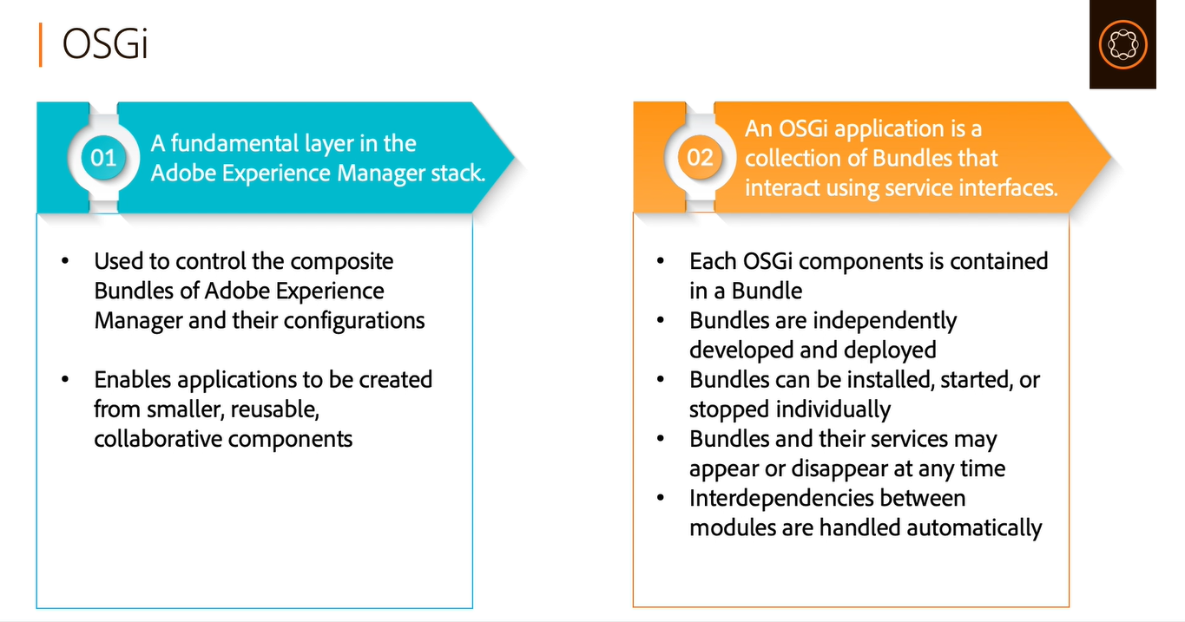

Slide 18
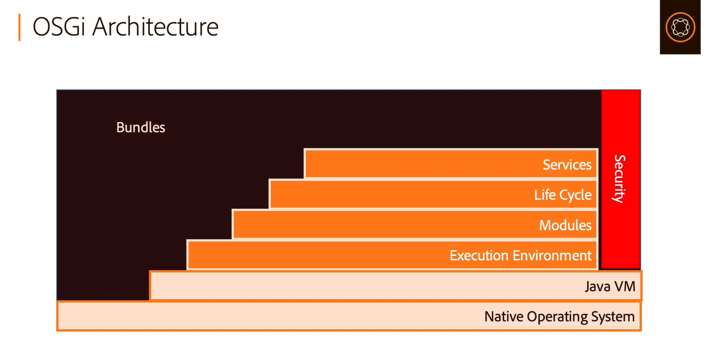

Slide 19
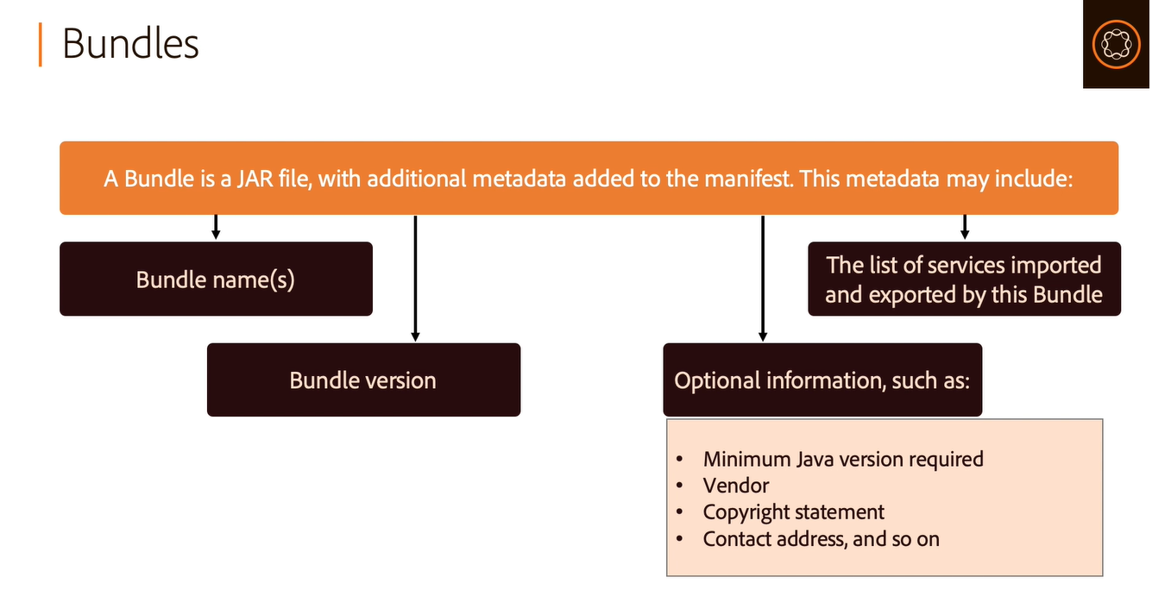

Slide 20
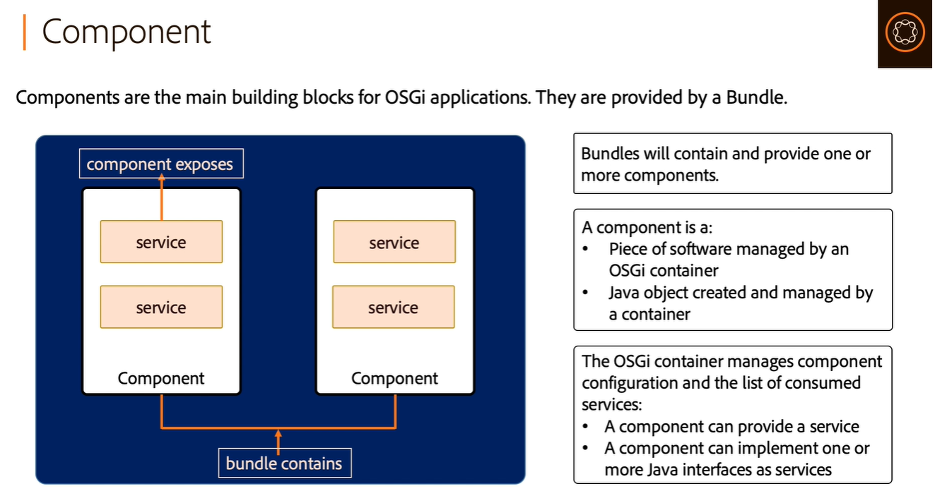

Slide 21
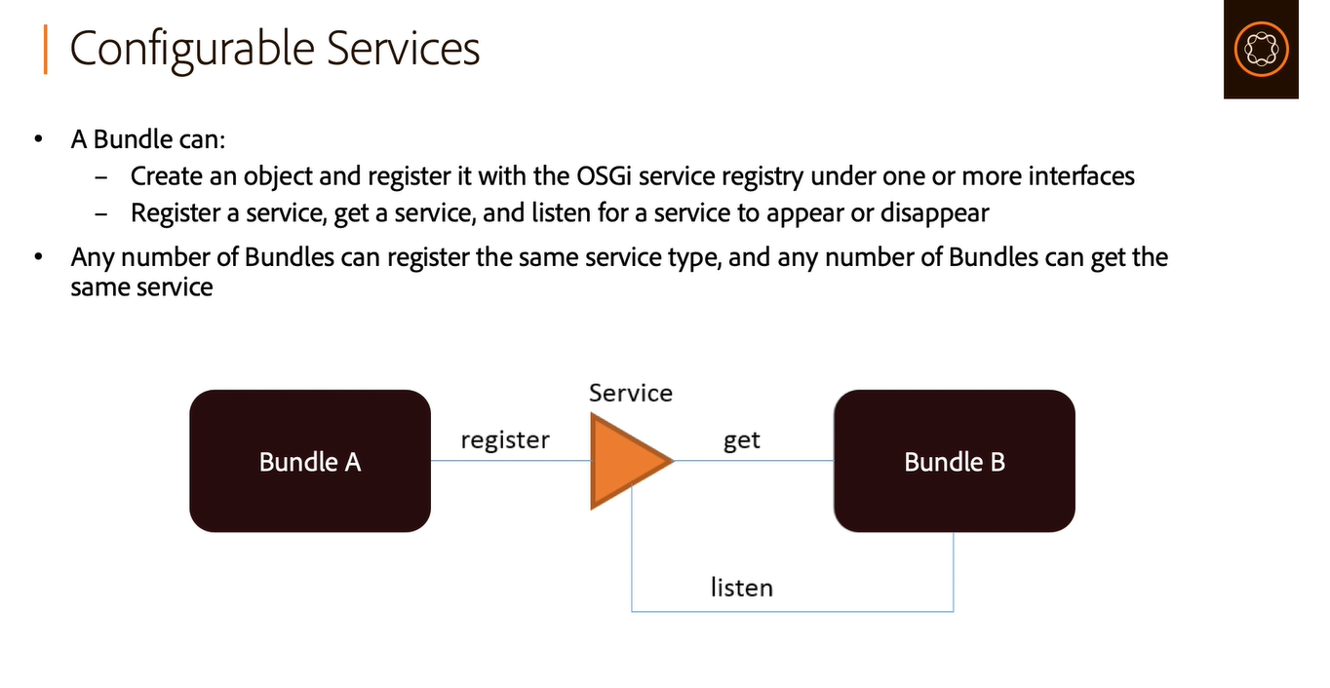

Slide 22


Slide 23
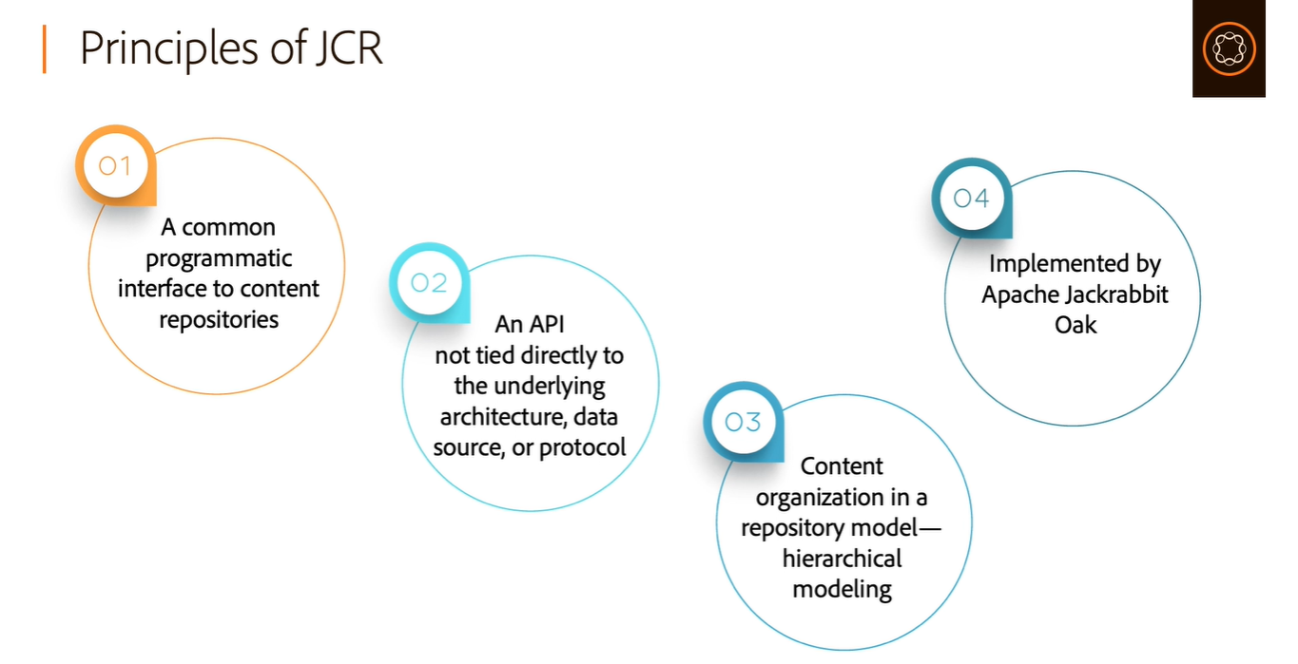

Slide 24
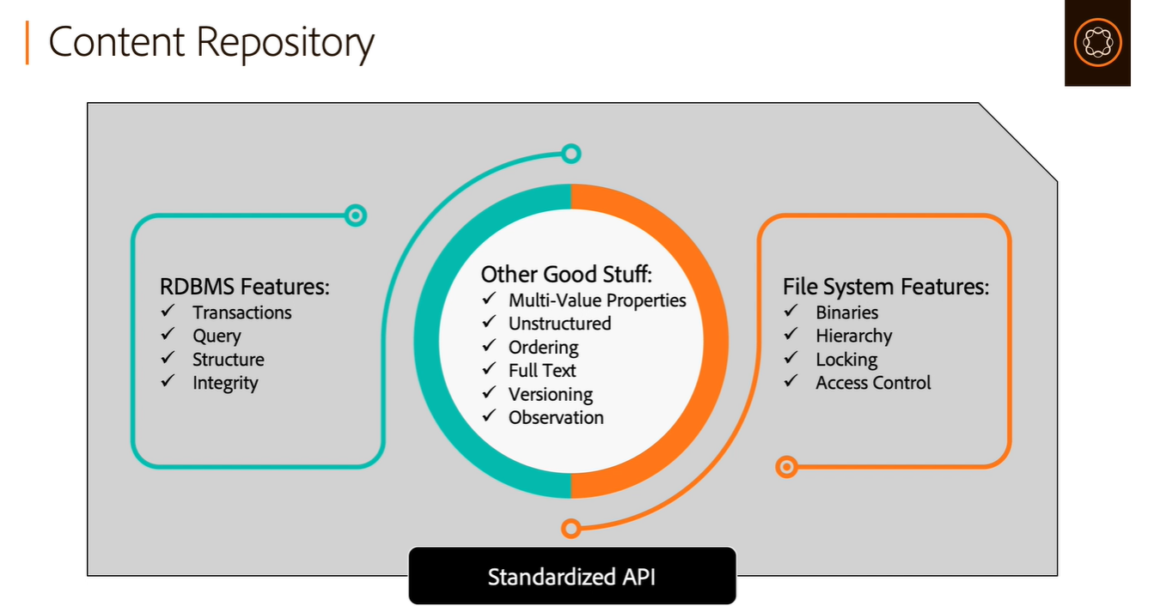

Slide 25
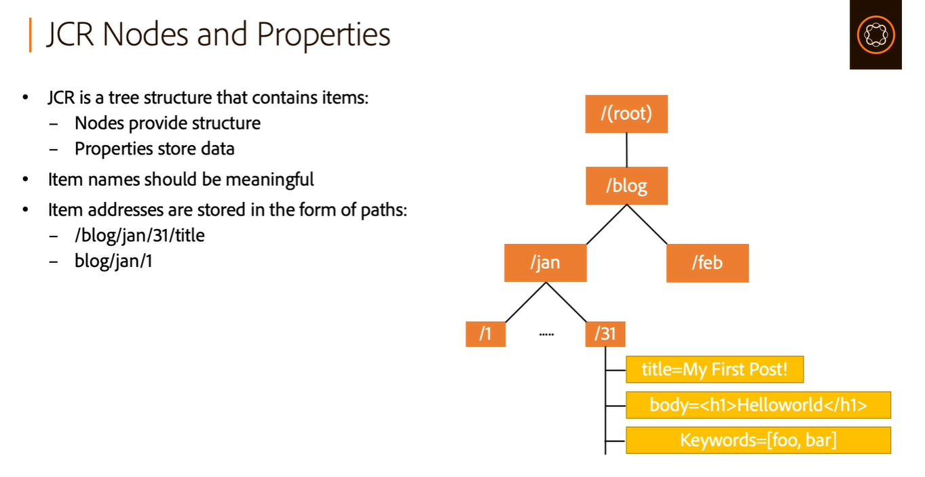

Slide 26
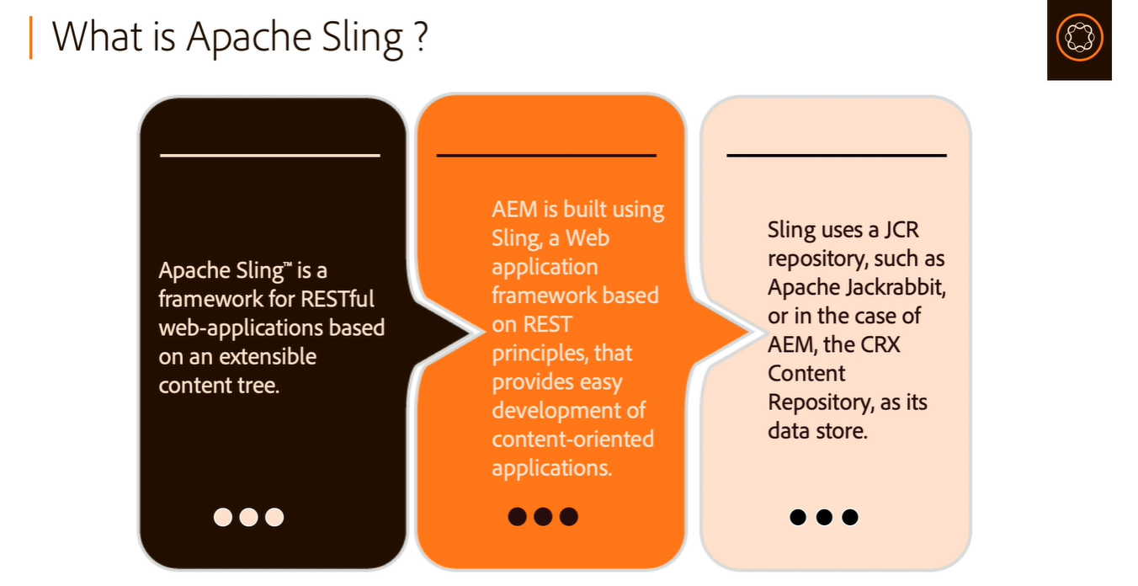

Slide 27
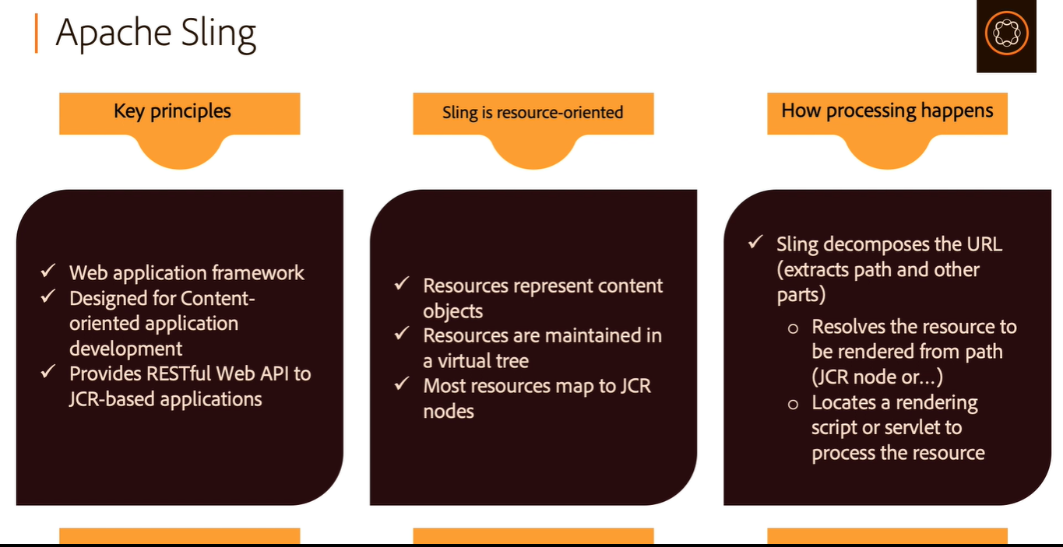

Slide 28
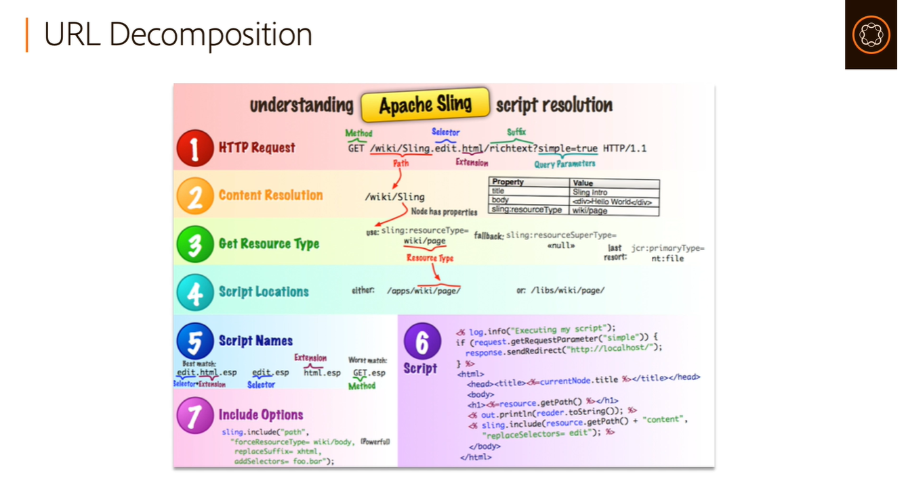

Slide 29
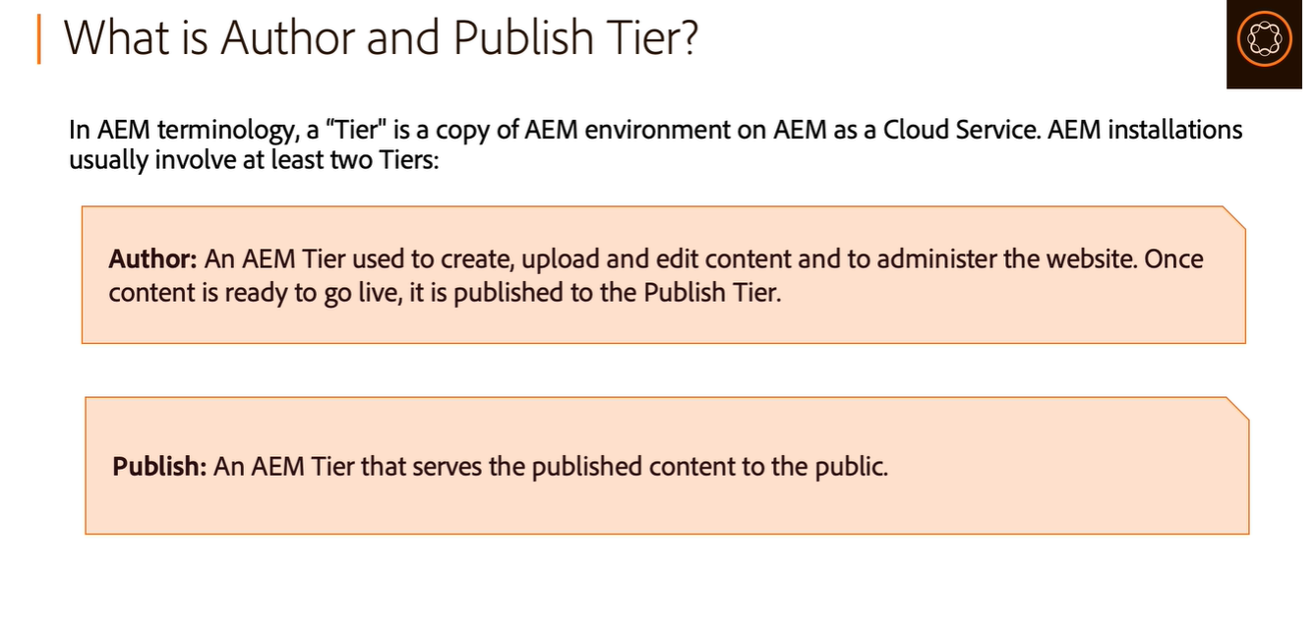

Slide 30
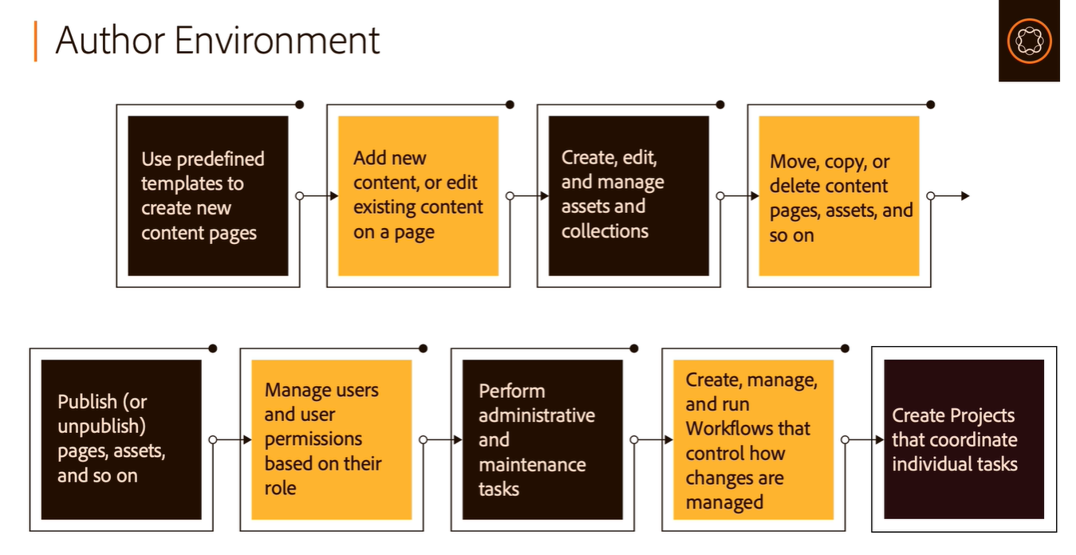

Slide 31
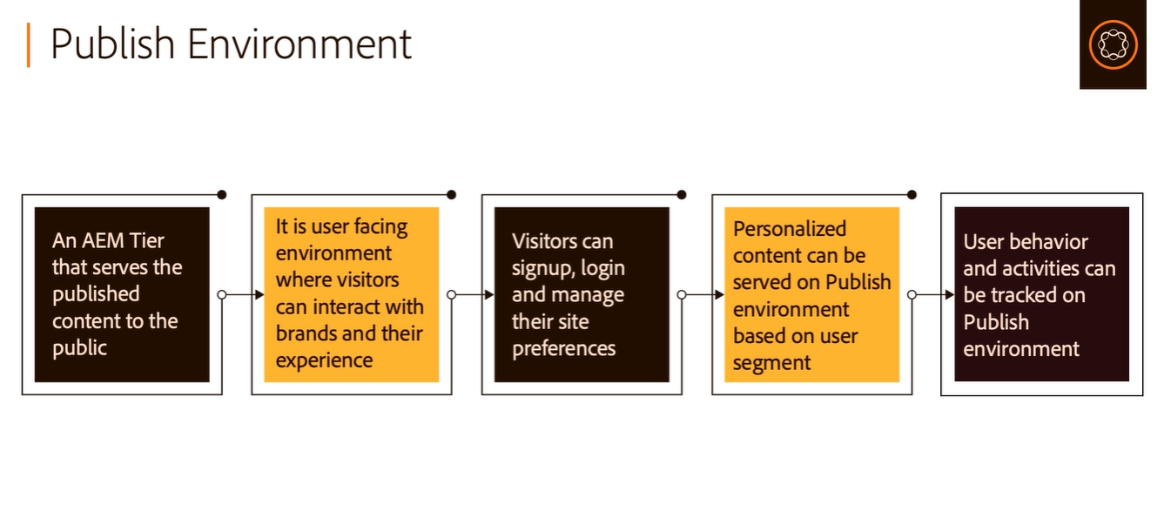

Slide 32
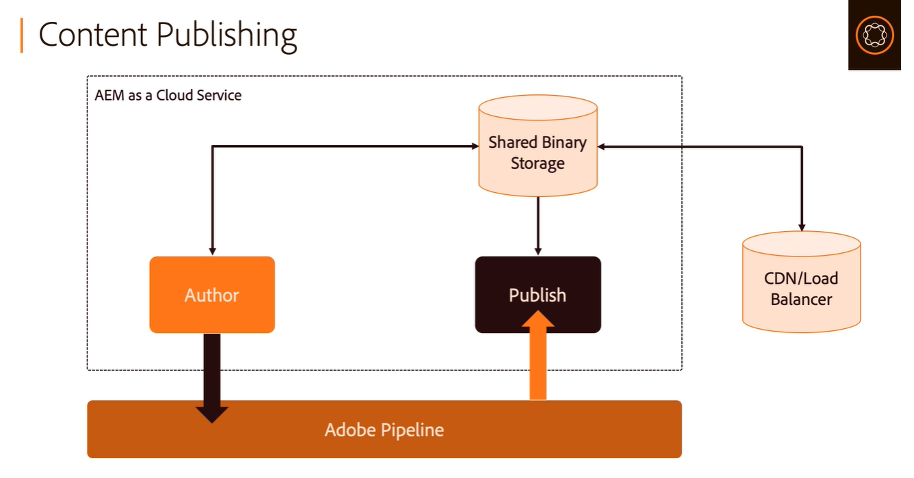

Slide 33
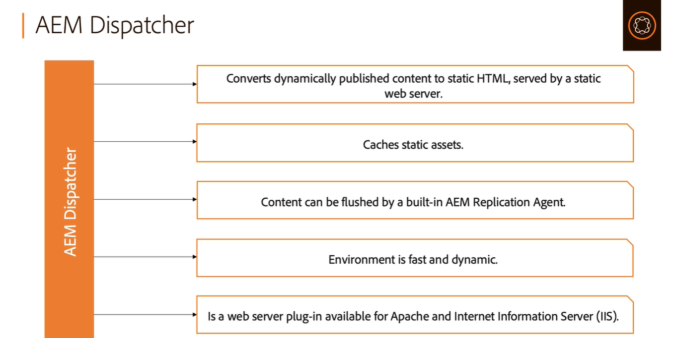

Slide 34
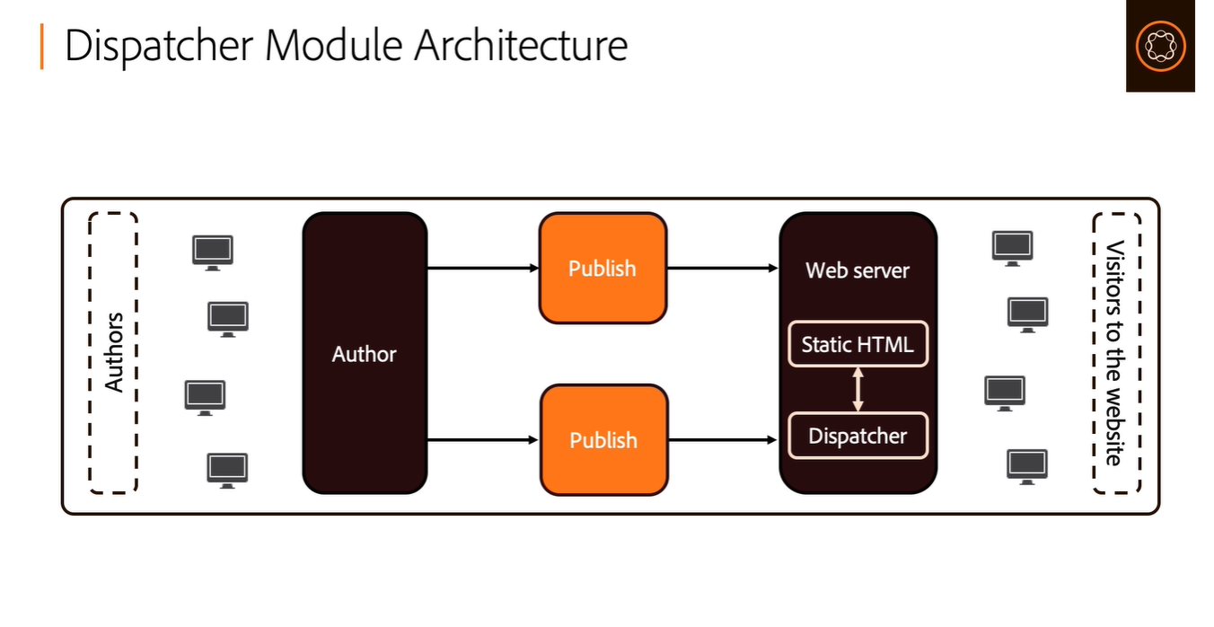

Slide 35
